Slide 1

27th September 2018
6:00pm to 7:30pm
Alan Gilbert Building, Melbourne University
161 Barry Street, Carlton VIC 3053

Slide 2
Welcome!

Slide 3
What we are
Creative problem-solving at the intersection of law and technology
Motivated by the hacker ethic of the 1960s and beyond.
Legal technology, open data, technology policy (net neutrality, data protection, etc).
Informed debate

Slide 4
What we are not
Computer security organization
Do not support or engage in illegal activities.
Trade association
Advocacy group (no position on policy issues and do not petition governments).

Slide 5
Community driven…
WE WANT YOU!

Slide 6
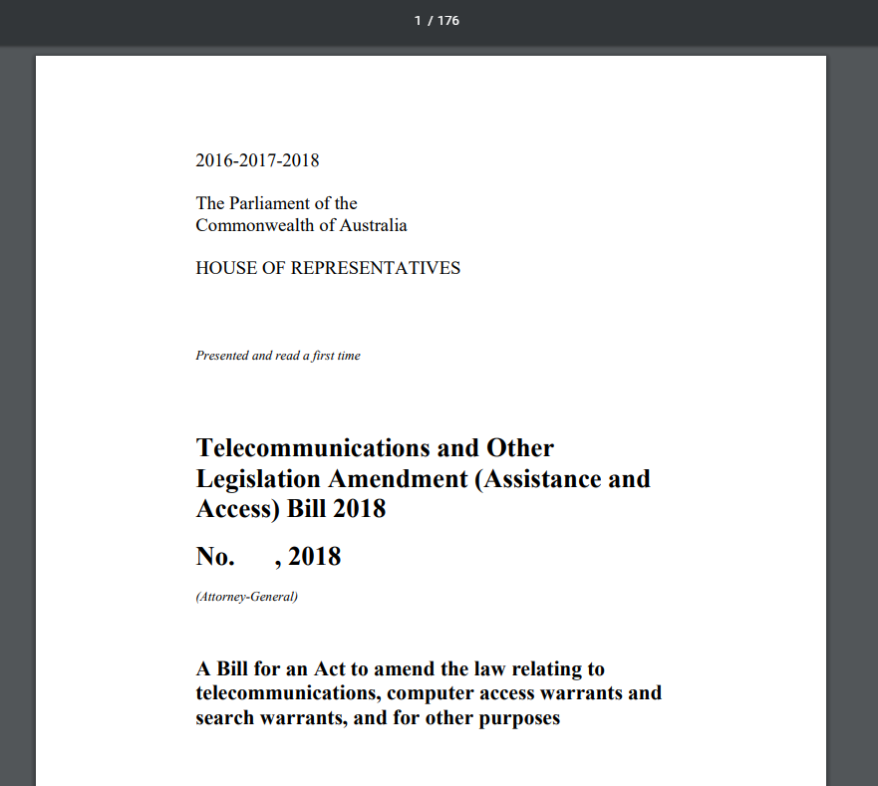
Without further ado…
The Assistance and Access Bill 2018
176 pages – maybe a bit too much for our first event
Do as best as I can in 10 minutes…

Slide 7
Why are people concerned?
Possibility of government-mandated “backdoors” in encryption.
But what does that mean? What is a backdoor? What is encryption?

Slide 8


Without further ado…
How can Bob communicate with Alice so that Eve can see the message in transit, but has no way of understanding it?
Long history in military
Julius Caesar crossing the English channel
WWII submarines
Satellite/microwave comms
Encipher!
But substitution cipher (e.g. a -> b, c->d) is easy to figure out and reverse. Better to use numbers!
Hello!
Hello!
Bob
Ifmmp?
Alice
Eve

Slide 9
Encryption
Cryptographic hashing - use prime numbers as keys!
Encrypt message with 91, since only Alice and Bob know that 91 = 7 x 13
With large numbers, very difficult for Eve to factorize/break!
hash(“Hello!” , 91) = asdsakldasjldjaslkjdlsak
Can only (tractably) decrypt with the right prime factors
Change one letter, change the hash
hash(“ello!H” , 91) = 1239873284923979
Hello!
Hello!
Bob
asdsakldasjldjaslkjdlsak
Alice
Eve

Slide 10
Why?
Hello!
Hello!
Computationally infeasible for Eve to eavesdrop
Great for banking, data security, medical, etc.
Not so great if Bob and Alice are bad guys.
Bob
asdsakldasjldjaslkjdlsak
Alice
Eve

Slide 11



In the real world…
Plain text goes in to the device before it gets encrypted, and comes out after it’s been decrypted.
Also, not all encryption is end-to-end – lots of infrastructure between Alice and Bob (telcos, application service providers, etc)
In (super) basic terms, government wants legal power to force them to store all those prime number factors, so they can come back later and decrypt messages.
Hello!
Hello!
Bob
!olleH
Alice
Eve

Slide 12

Cryptocurrencies?
Why crypto?
(From not-a-cryptocurrency expert)
Let’s say everyone in the room is identified by a prime number and has a piece of paper with 100 blagcoins on it
Day 1 - #3 writes a promissory note to #7 for 20 blagcoins
Day 2 = #7 writes a promissory note to #11 for 120 blagcoins
How does #11 know that #3 gave #7 anything?

Slide 13
Cryptocurrencies?
Why crypto?
(From not-a-cryptocurrency expert)
Crytographically hash every promissory note
From To Amount
#3 #7 20 blagcoins
hash(“#3 -> #7 -> 20”) = asjdklsadlkasjdlkasjl
Crucially, this hash is then used to sign the next transaction
hash(“#7 -> #11 -> 120”, asjdklsadlkasjdlkasjl)
…and so on and so forth…

Slide 14
Cryptocurrencies?
Every transaction hash is calculated on the hash of every preceding transaction
Anyone can verify - distributed trust
Link with cryptography – I can verify that you sent a particular message, and that nothing has been altered in transit.
In simple terms – 21st century method to stop people passing bad cheques!

Slide 15
Want to know more?
Lightning talk only
Law/tech behind cryptography is not my area of expertise
Want to sink your teeth deeper?
Please put your hand forward to give a more in-depth talk!

Slide 16
Want to know more?
https://github.com/nmfisher/presentations/blob/master/lh-presentation-crypto-sept-2018.pptx

Slide 17




@LegalHackersMelbourne
Legal Hackers Melbourne
legalhackersmelburn@gmail.com
THANK YOU AND SEE YOU NEXT TIME!!

